Slide 1
MIKE 11
Structures

Slide 2
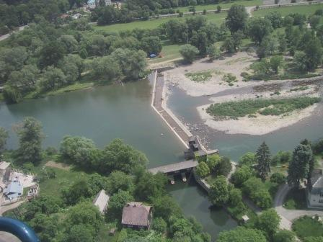
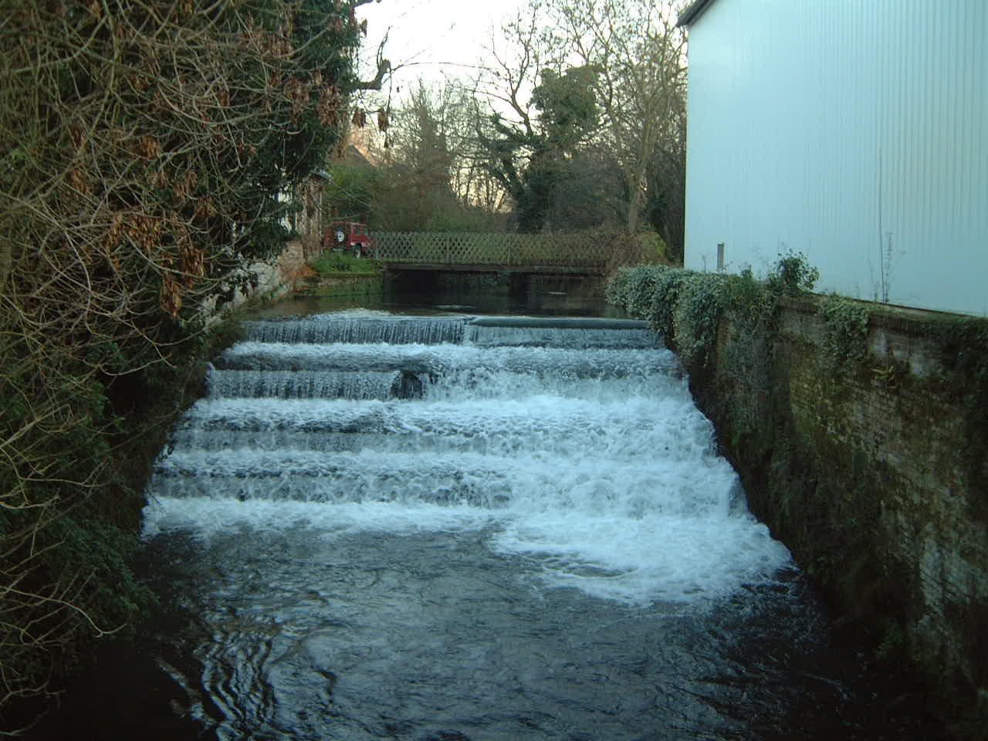
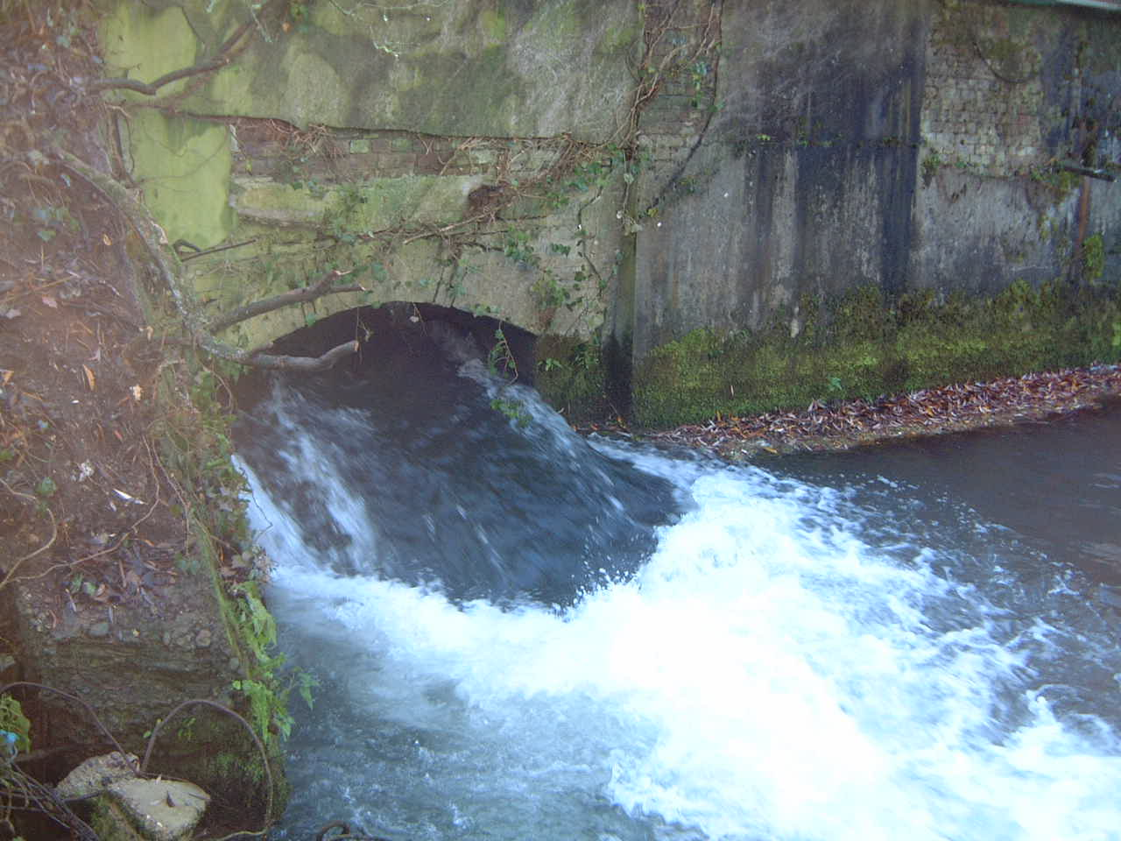
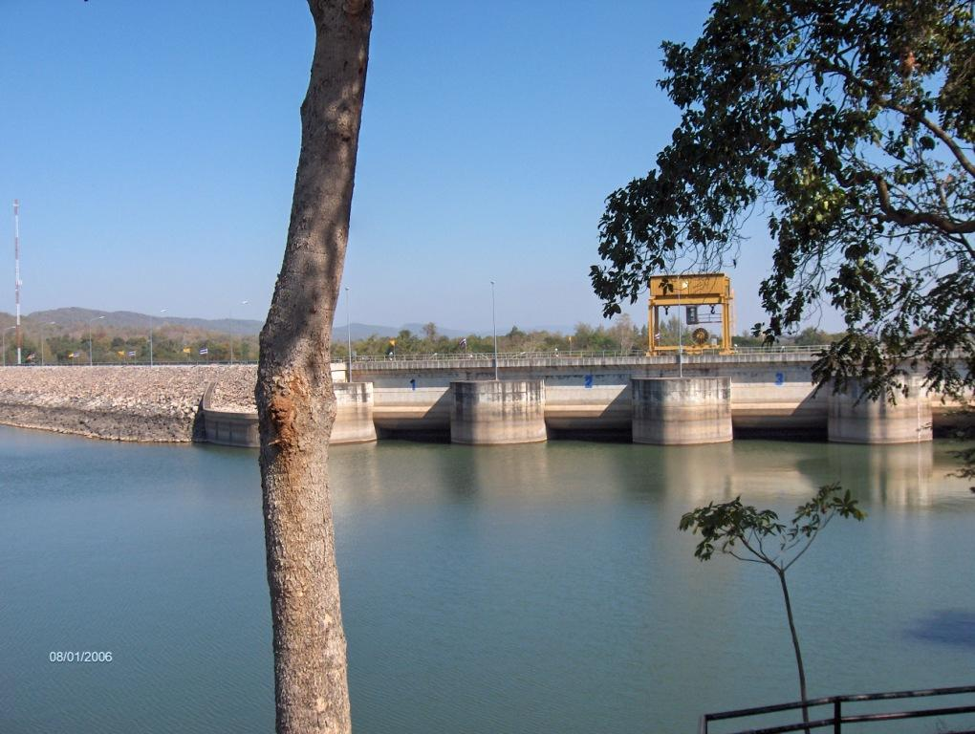
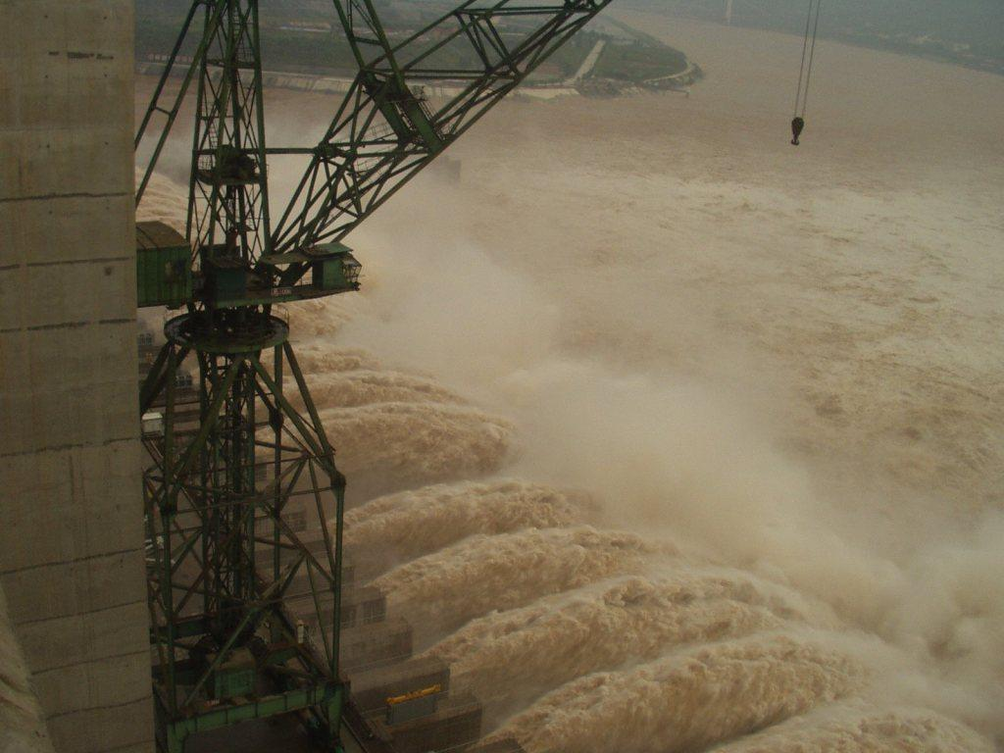
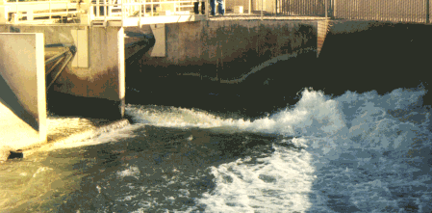
MIKE 11 STRUCTURES
Wide Range of Structures Requested – and Available in MIKE 11 (also MIKE 1D)

Slide 3
MIKE 11 STRUCTURES
Defined in the Network File
How? Network File -> View -> Tabular View -> Structures Page
Requires Knowledge
of PASCAL Code

Slide 4
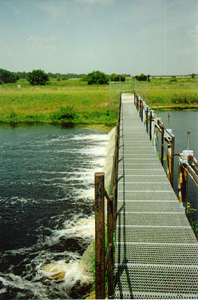
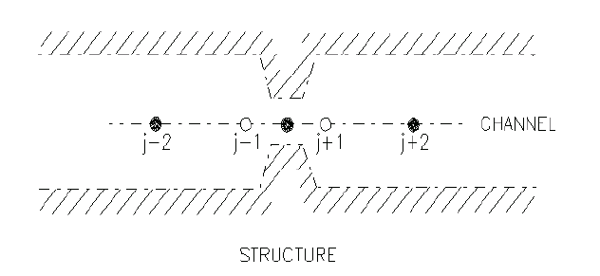
MIKE 11 STRUCTURES
Issues Related to the Finite Difference Scheme
A Structure is a Contraction/Expansion by Definition
Structures are located at Q-points in the FD Scheme
Multiple Structures can Exist at the Same Q-point to Define Complex Geometries (must have unique ID)
Q H Q H Q

Slide 5
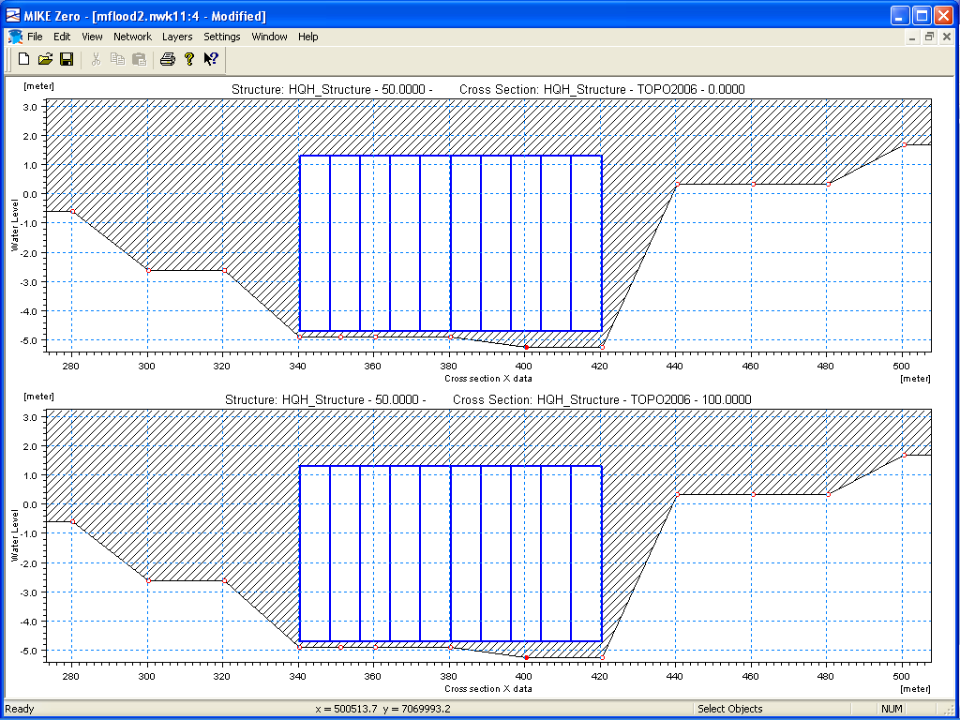
MIKE 11 STRUCTURES
Geometric Requirements for Structures
Upstream and Downstream Cross-Sections must exist in the Database at a Distance less than Dx-max from the Structure
For greater Stability and Accuracy, Upstream and Downstream Cross-Sections should not be located too far away from Structures.
Structure Width must be less than both the Upstream and Downstream Cross-Sections FOR ALL LEVELS
Tip: Avoid Using “Effective Area, Hydraulic Radius” Type Sections near Structures

Slide 6
MIKE 11 STRUCTURES
Additional Structure Features
Valve regulation to allow flow in one direction only - e.g. for flap gate operation
Group structures in parallel to describe complex geometries (eg combined structure flow and overtopping) ‘Parallel structures’ are defined by identical Branch and Chainage definition for two or more structures. Recommended to differentiate parallel structures by the Structure ID
Eventual overtopping defined
by an overflow weir
Bridge openings:
Culvert #1
Culvert #2
Culvert #3

Slide 7
MIKE 11 STRUCTURES
Internal Conditions Applied at a Structure
Structures impose internal boundary conditions:
a) due to a control somewhere in the structure Q_{str} = f (H_{u/s})
b) due to energy losses through the structure, Q_{str} = f (H_{u/s}, H_{d/s})
MIKE 11 looks at both cases and decides which is the governing mechanism
In the FD Scheme, the Momentum Equation is replaced with:
the control equation for (a), or
the local energy balance for (b)

Slide 8
MIKE 11 STRUCTURES
Upstream Control
Control somewhere in
the structure, Q_{str} = f (H_{u/s})
For Example:
Weir; Free flow
Culvert; Inlet critical
Outlet critical
Orifice flow at inlet
Full barrel flow
Zero Flow, Upstream or
Inlet Controlled

Slide 9
MIKE 11 STRUCTURES
Downstream Control
Energy losses through the structure,
Q_{str} = f (H_{u/s}, H_{d/s})
For Example:
Weir; Drowned flow over the weir
Culvert; Drowned flow through the culvert
Downstream or Outlet Controlled

Slide 10
MIKE 11 STRUCTURES
Head Loss at Structures
H_{LOST} is a function of Q and is due to:
Eddy losses / vortices / turbulence
Contraction / expansion of streamlines
U/S
1
D/S
H
h
H
2
h

Slide 11
MIKE 11 STRUCTURES
Loss Coefficient, ζ
Contributions from Inflow and Outflow
Note:
A_{s} < A₁ and A₂

Slide 12
MIKE 11 STRUCTURES
Coupled set of Equations
Full Energy loss
Solve with respect to Q and h_{s}
Energy loss from upstream to structure

Slide 13
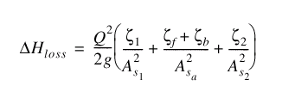
MIKE 11 STRUCTURES
Total Head Loss
Contributions from:
outflow
bend (for culverts)
friction (for culverts)
inflow
Note: Subject to ζ_{min} specified in the HD11 File, Default Values Page
A_{sa} Average
Structure Area

Slide 14
MIKE 11 STRUCTURES
Specifying Loss Coefficients
Defaults:
ζ_{in} = 0.5
ζ_{out} = 1.0
Determine from:
Flume tests
Field measurements
Model calibration
Free Overflow Q = a_{c} Q_{c}
Q_{c} is tabulated
a_{c} is applied during simulation
Weirs
Culverts
a_{c} = 1 is Default
a_{c} > 1, for non-parallel flow (curved streamlines)
a_{c} < 1, for side effects
Function of the Degree of Smoothness at Entry and Exit

Slide 15
MIKE 11 STRUCTURES
Features of broad crested weirs
The flow over a broadcrested weir is governed by
the steady state energy balance
Features of broadcrested weir:
Arbitrary shape
User defined head loss coefficients
Contraction loss and expansion loss
Notes of caution:
Flow area restrictions
Ensure that free flow conditions are pre-calculated
No friction loss over weir
Water level variations have an instantaneous
effect on flow over weir

Slide 16
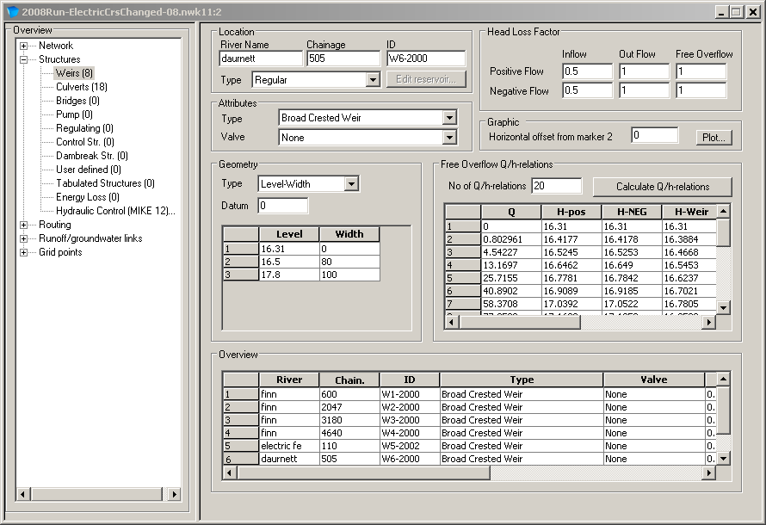
MIKE 11 STRUCTURES
Weirs GUI

Slide 17
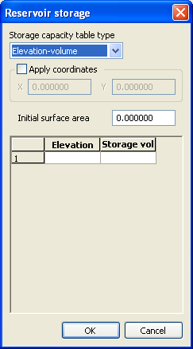
MIKE 11 STRUCTURES
Weir Types
Regular, Side Structure and Side Structure + Reservoir
Q – Q _{lost}
Q – Q _{reservoir}
Q _{reservoir}
Q_{lost}
Q
Q
Storage in Reservoir/Pond
Side Structure
Side Structure + Reservoir

Slide 18
MIKE 11 STRUCTURES
Weir Attributes and Geometry
Five (5) Attribute Types
Defined as Level-Width Relationship or Using Cross-Section in Database at the Same Chainage
Selecting Weir Formulas Results in Different Dialog Boxes for Parameters

Slide 19
MIKE 11 STRUCTURES
Broad Crested Weir and Special Weir
Broad Crested Weir
Level-Width
Cross Section DB
Special Weir has Same Geometric Input as Broad Crested Except the Q/h Relations can be Manually Inserted

Slide 20
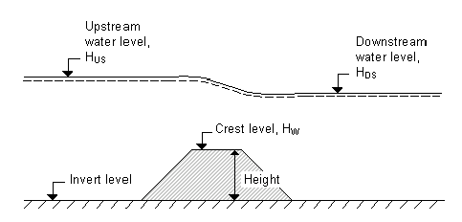
MIKE 11 STRUCTURES
Weir Formula 1 (Villemonte)
Standard Weir Expression Reduced According to the
Villemonte Formula

Slide 21
MIKE 11 STRUCTURES
Weir Formula 2 (Honma)
Honma Formula
for Weir Flow

Slide 22
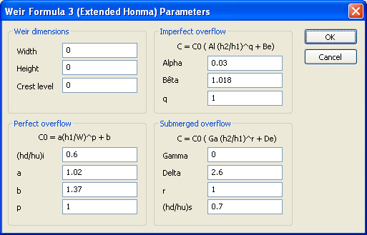
MIKE 11 STRUCTURES
Weir Formula 3 (Extended Honma)
Extended Honma Formula for Weir Flow

Slide 23
MIKE 11 STRUCTURES
Culvert formula
Entrance loss
Exit loss
Friction loss
Bend loss

Slide 24
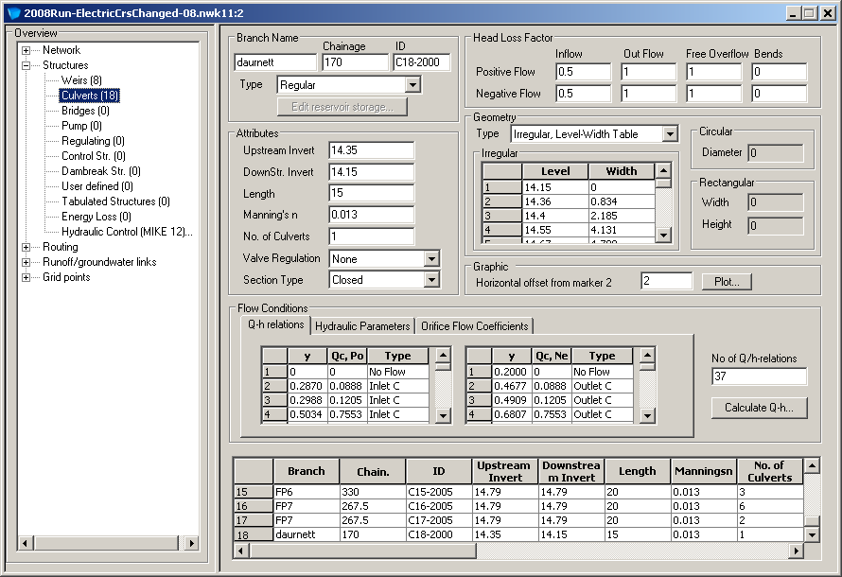
MIKE 11 STRUCTURES
Culverts GUI

Slide 25
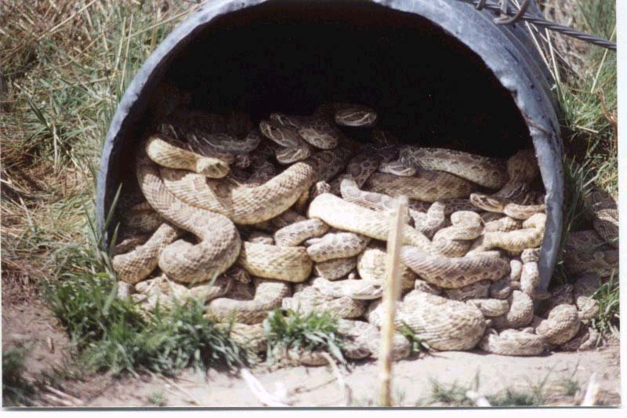
MIKE 11 STRUCTURES
Culverts
Same Types as Weirs (including Side + Reservoir)
Culverts are similar to Weirs, except:
Culverts have Length, therefore a Friction Loss
Culverts have a Soffit, therefore a possible Orifice Control Mechanism (and Vena Contractor effect)
Culverts have a Bend Loss Option

Slide 26
MIKE 11 STRUCTURES
Pumps
Same Types as Weirs (including Side + Reservoir)
Specification Types:
- Fixed Discharge (Q)
- Table of Q ‘vs’ dH
A Pump is a Special Type of Regulating Structure

Slide 27
MIKE 11 STRUCTURES
Regulating Structures
Same Types as Weirs (including Side + Reservoir)
A Regulating Structure can be a Function of Time or h/Q at any Location
Notes:
FOR EXAMPLE applied where discharge through a dam is to be regulated as a function of the water level and the inflow to the reservoir.
The structure is regulated as a pump.

Slide 28
MIKE 11 STRUCTURES
Regulating Structures
Function of Time Q = f (t):
pumps, reservoir outlet, historical release
specified in Boundary (BND11) Editor
Q (t) specified in Time Series (DFS0) File
Function of h/Q at a Location Q = A Z_{a}, where: Z_{a} is H or Q at location a
A is a coefficient given by A = f (Z_{b})
Z_{b} is H or Q at location b
Examples: Bifurcation, Q_{bif} = f (Q_{u/s})
Reservoir, Q_{out,res} = f (Q_{in}, H_{res})
Dummy branch, Q = 1 or Q = f (Z_{b})

Slide 29
MIKE 11 STRUCTURES
Tabulated Structures
User Defined Tables of Flow ‘versus’ Level
Calculation Modes:
Q_{str} = f (H_{u/s}, H_{d/s})
H_{u/s} = f (Q_{str}, H_{d/s})
H_{d/s} = f (Q_{str}, H_{u/s})
Some Pumps can be Modelled as a Tabulated Structure with Q_{pump} = f (H_{u/s}, H_{d/s})

Slide 30
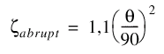
MIKE 11 STRUCTURES
Local Energy Loss
Used to model:
Abrupt Changes in Alignment
Gradual Changes in Alignment
User defined energy loss
Flow contraction loss
Flow expansion loss
where, α = 0.1 to 0.2

Slide 31
MIKE 11 STRUCTURES
(In)-Stability in Structures
Ensure there is sufficient headloss through the structure. A very small headloss leads to an ill-conditioned solution  Increase energy loss or remove structure
Ensure a monotonically increasing Q/h-relation
⇒ Edit the Q/h-relation by hand or change structure geometry
Ensure gradual variation in structure area
⇒ Alter structure area slightly
Also play with Delta, Delhs, Zetamin and Inter1Max in the HD11 file, default values page

